Slide 1
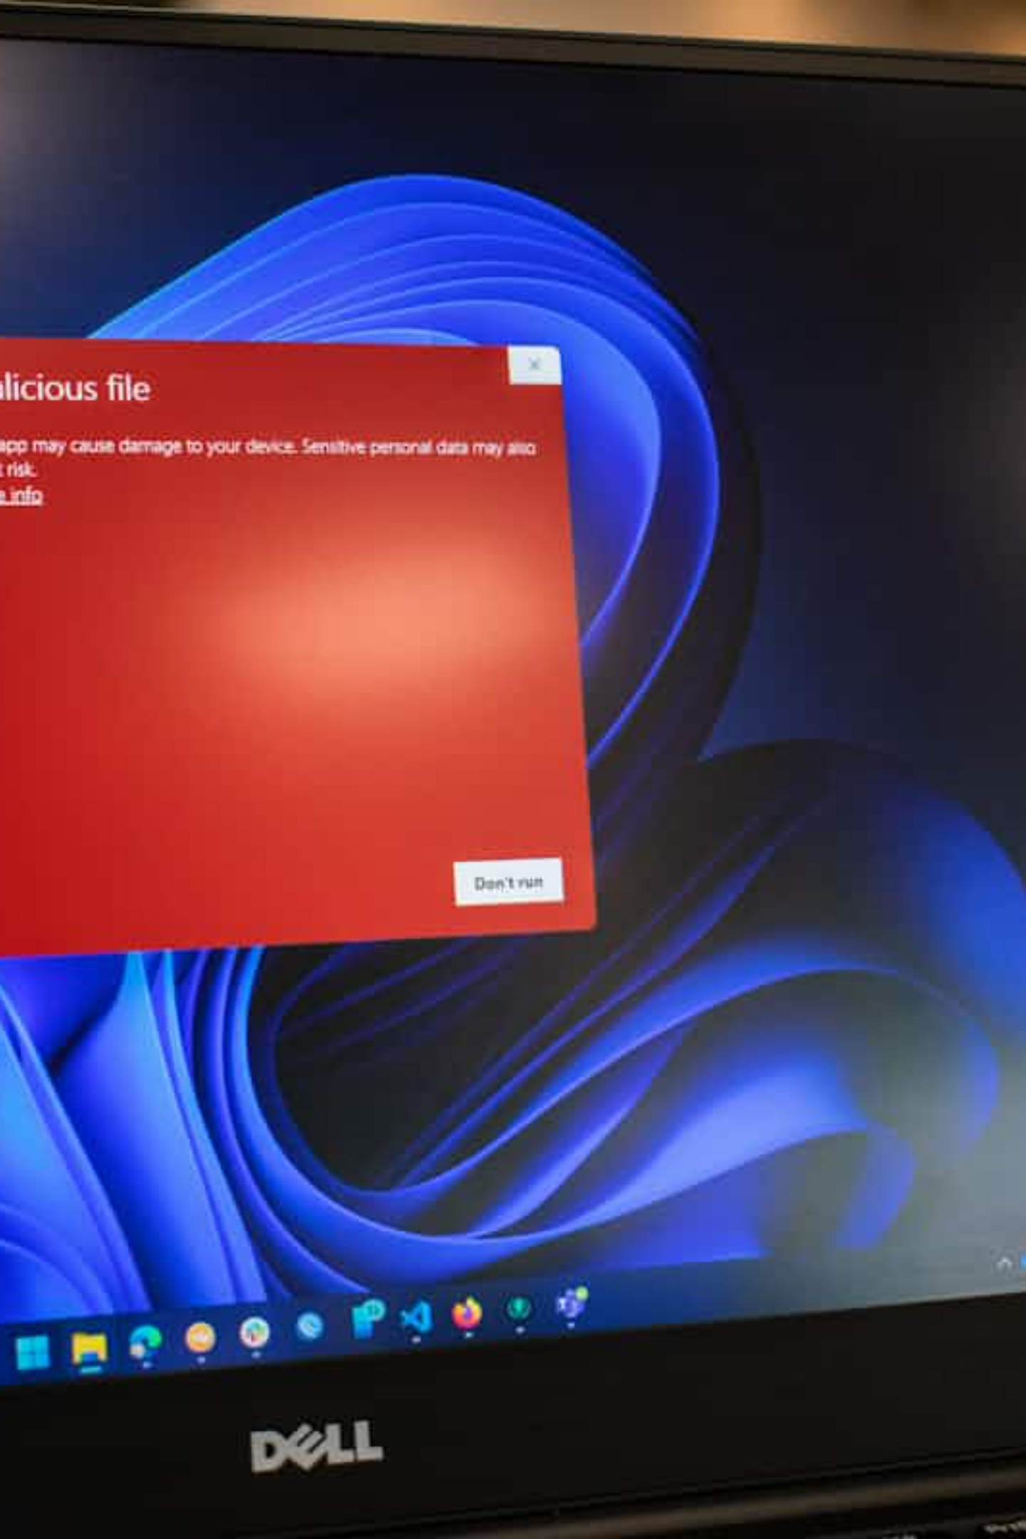
Process Hacker: A Powerful Tool for Malware Analysis
Process Hacker is an open-source tool that allows security professionals to monitor running processes, identify resource-intensive programs, and track network connections associated with specific processes. These capabilities make it invaluable for malware analysis and incident response, helping analysts gather critical indicators of compromise (IOCs) such as malicious IP addresses and domains.

Slide 2

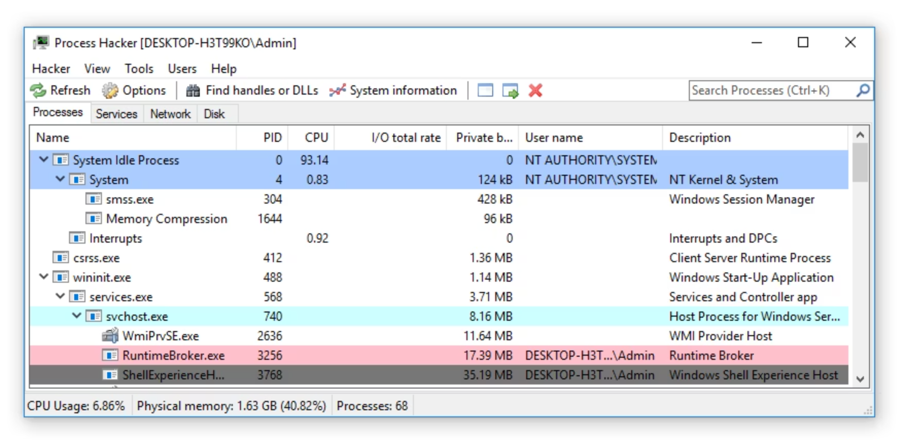
Understanding Process Hacker's Interface
The main interface displays running processes with detailed information including:
Process Information
Name of the running process and its unique Process ID (PID)
Resource Usage
CPU consumption, I/O total output, and private bytes
User Context
User name that launched the process and a description of what the process does
Processes are color-coded for quick identification, which helps distinguish between system processes and potentially suspicious ones.

Slide 3
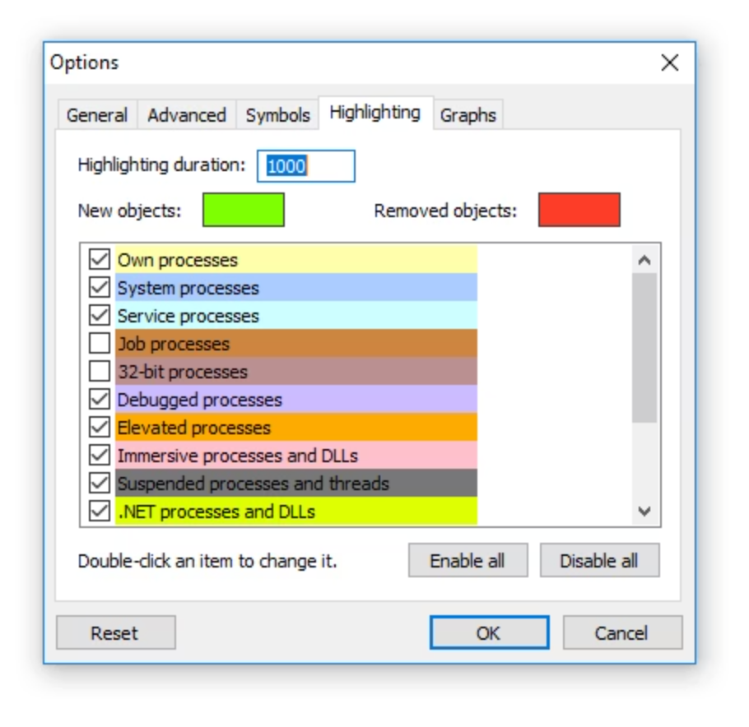
Color Coding for Quick Analysis
Process Highlighting
Process Hacker uses color coding to help analysts quickly identify different types of processes. This visual differentiation makes it easier to spot potentially suspicious activity among legitimate system processes.
To view what each color represents, navigate to 'Hacker' → 'Options' → 'Highlighting' tab in the menu.
This color system helps security professionals quickly distinguish between expected system processes and potentially suspicious ones, such as packed processes that might indicate malware.

Slide 4

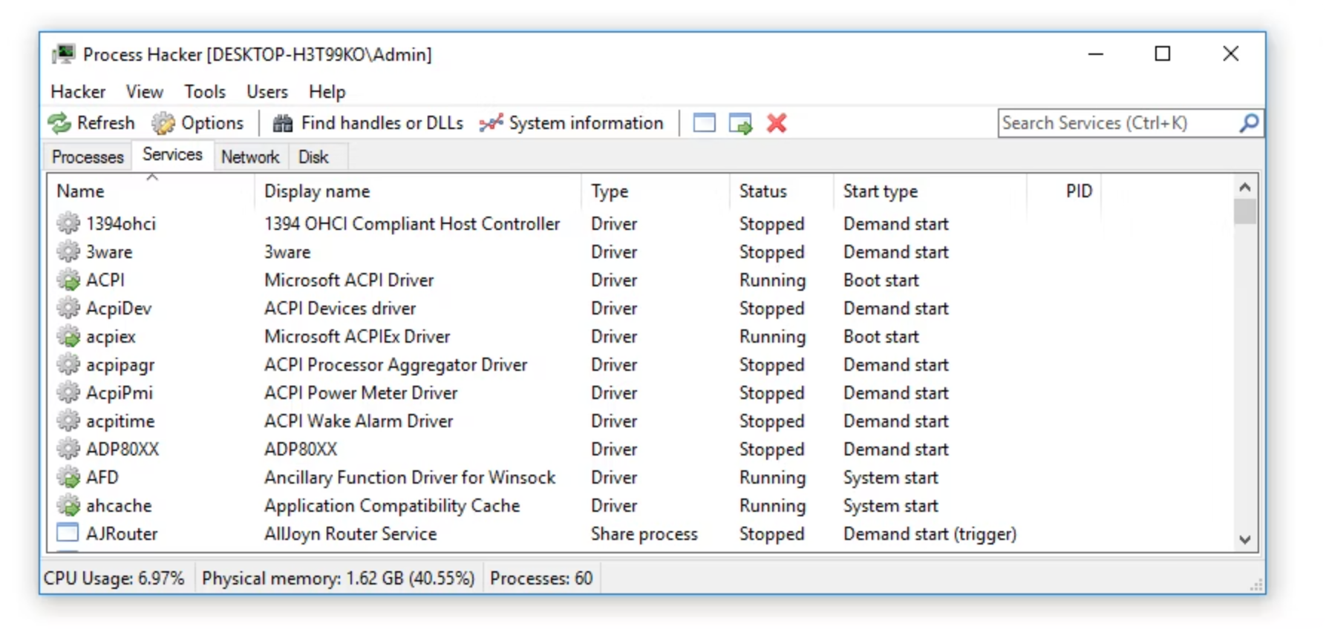
Monitoring Services and Background Processes
The 'Services' tab provides visibility into background processes that don't interact with the desktop. For each service, Process Hacker displays:
Name and display name of the service
Type of service (e.g., Driver)
Current status (Running, Stopped)
Start type (Boot start, Automatic, Manual)
Associated process identifier when available
This information is crucial for identifying potentially malicious services that might be running in the background without the user's knowledge.

Slide 5

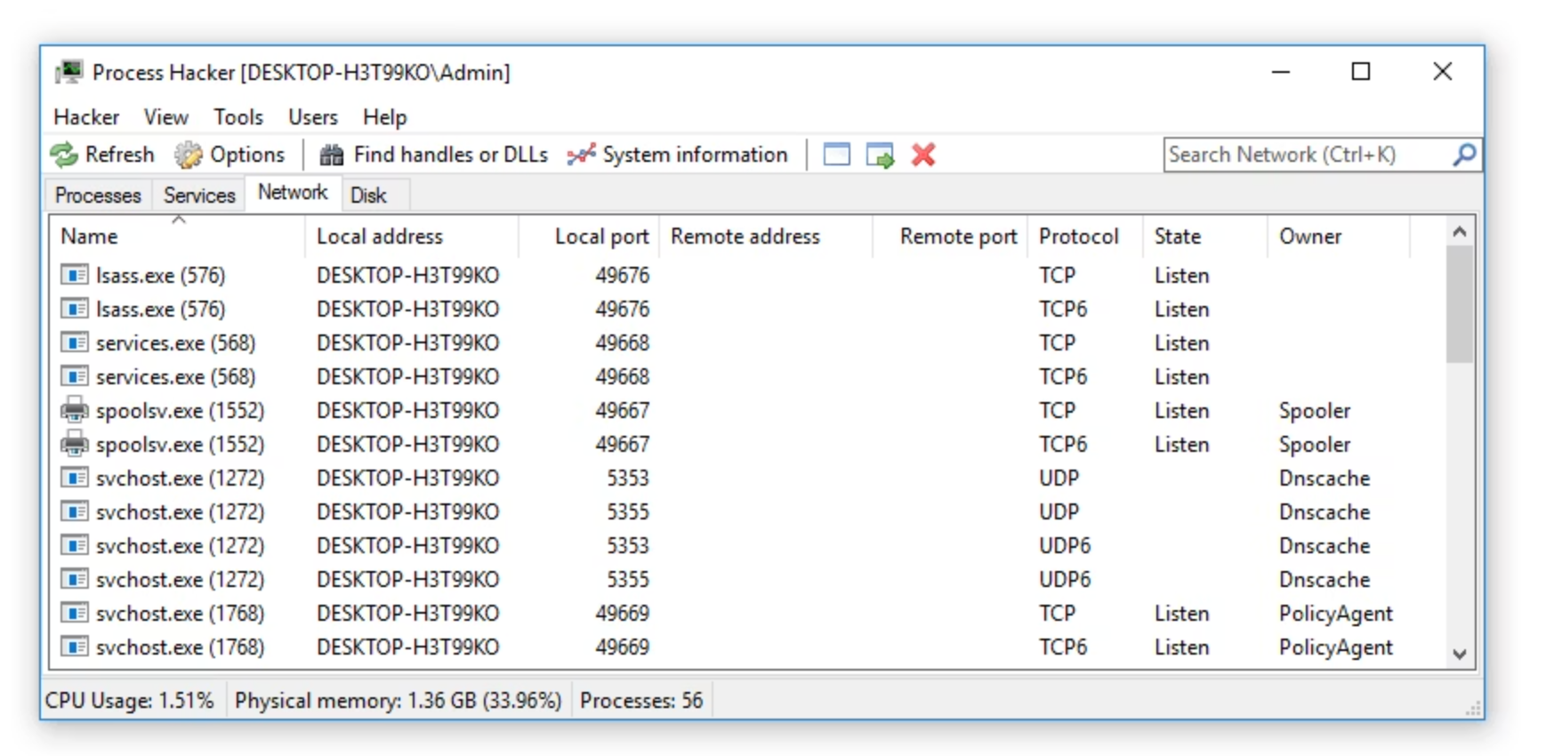
Tracking Network Connections
Process Details
Process name, PID, and owner information
Local Connection
Local address and port used by the process
Remote Connection
Remote address and port the process is connecting to
Connection Details
Protocol used and current state of the connection
The Network tab is particularly valuable for malware analysis, as malicious software typically attempts to communicate with command and control (C2) infrastructure.

Slide 6

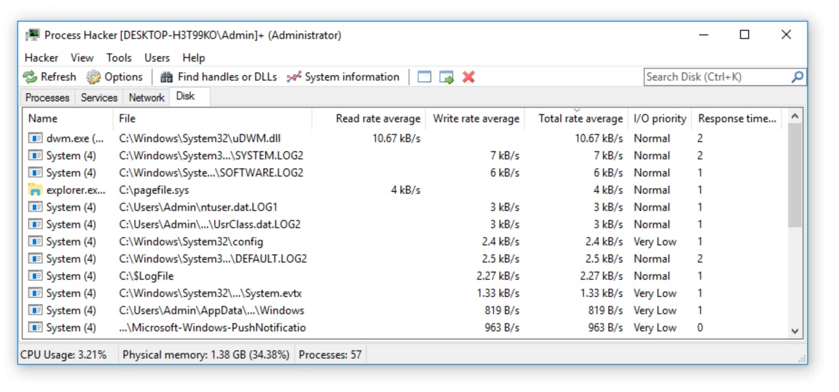
Monitoring Disk Activity
The 'Disk' tab provides real-time information about files being accessed on the device's hard drive, including:
Process name and PID
Write rate average in real-time
File location on disk
Total rate average of read/write
Read rate average in real-time
I/O priority and response time
This information helps identify suspicious file operations that might indicate data exfiltration or encryption activities typical of ransomware.

Slide 7
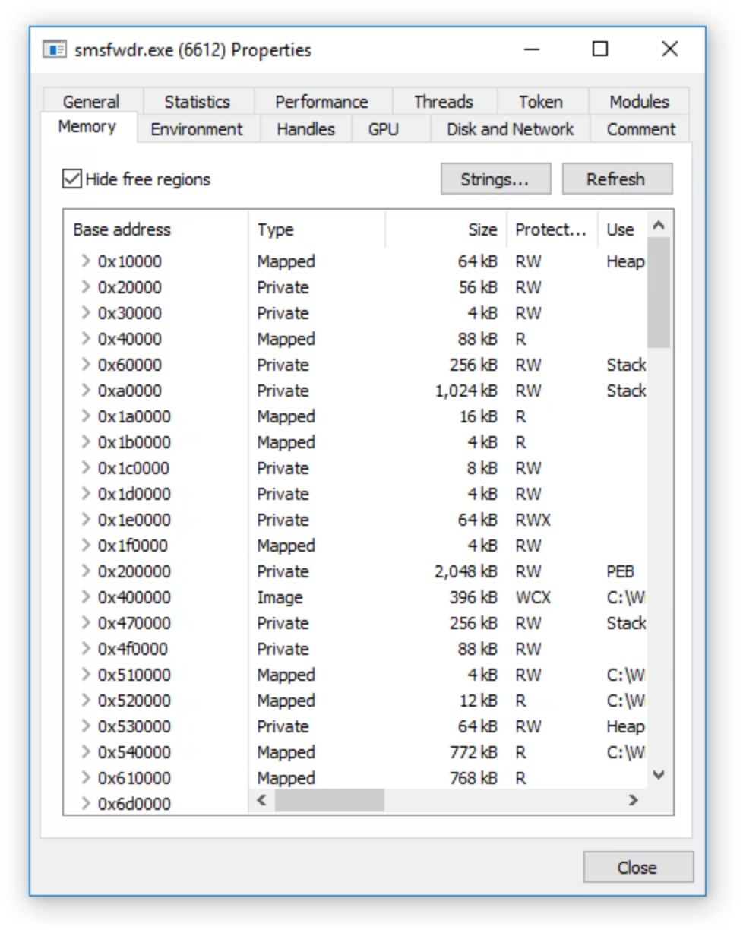
Extracting Strings from Memory
Memory Analysis Process
Right-click on a suspicious process and select 'Properties'
Navigate to the 'Memory' tab
Click the 'Strings...' button to search for strings in memory
Use the 'Filter' button to enable regex searching
This powerful feature allows analysts to extract valuable indicators of compromise directly from a running malware's memory space.
Memory analysis is one of Process Hacker's most valuable features for malware investigation, as it can reveal information that might be obfuscated in the malware's code.

Slide 8

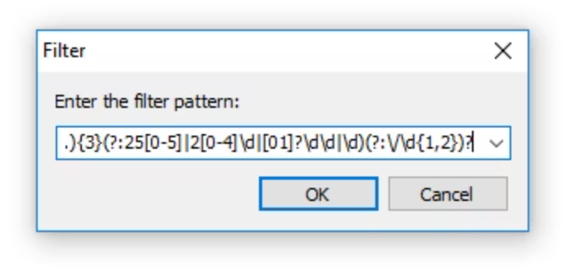
Using Regular Expressions to Find IOCs
Process Hacker supports regex-based filtering to efficiently identify indicators of compromise in memory:
Finding IP Addresses
Finding URLs
Use regex pattern: (?:(?:\d|[01]?\d\d|2[0-4]\d|25[0-5])\.){3}(?:25[0-5]|2[0-4]\d|[01]?\d\d|\d)(?:\/\d{1,2})?
Use regex pattern: ([A-Za-z]+://)(-\w+(?:\.\w[-\w]*)+)(:\d+)?(/[^.!,?"<>\[\]{}\s\x7F-\xFF]*(?:[.!,?]+[^.!,?"<>\[\]{}\s\x7F-\xFF]+)*)?
These patterns help security professionals quickly identify malicious network indicators that can be used to block communication with command and control servers.

Slide 9

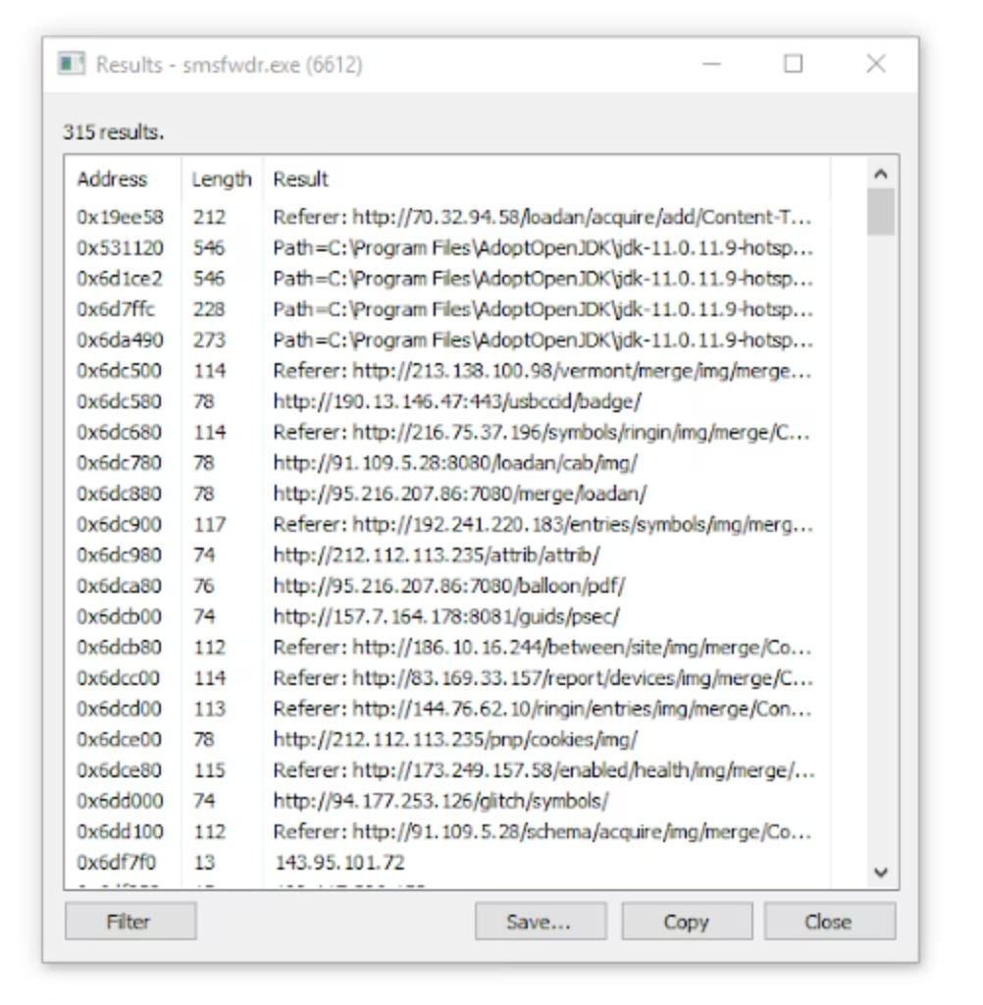
Discovering C2 Infrastructure
When analyzing malware with Process Hacker, the memory strings analysis can reveal command and control (C2) infrastructure:
IP addresses attempting to connect to C2 servers
Communication protocols being used (often HTTP)
Potential false positives that need to be filtered out
This information is invaluable for security teams to:
Verify if these IP addresses are blocked by existing security controls
Update security controls to block newly discovered malicious infrastructure
Check if any devices in the organization are communicating with these addresses

Slide 10

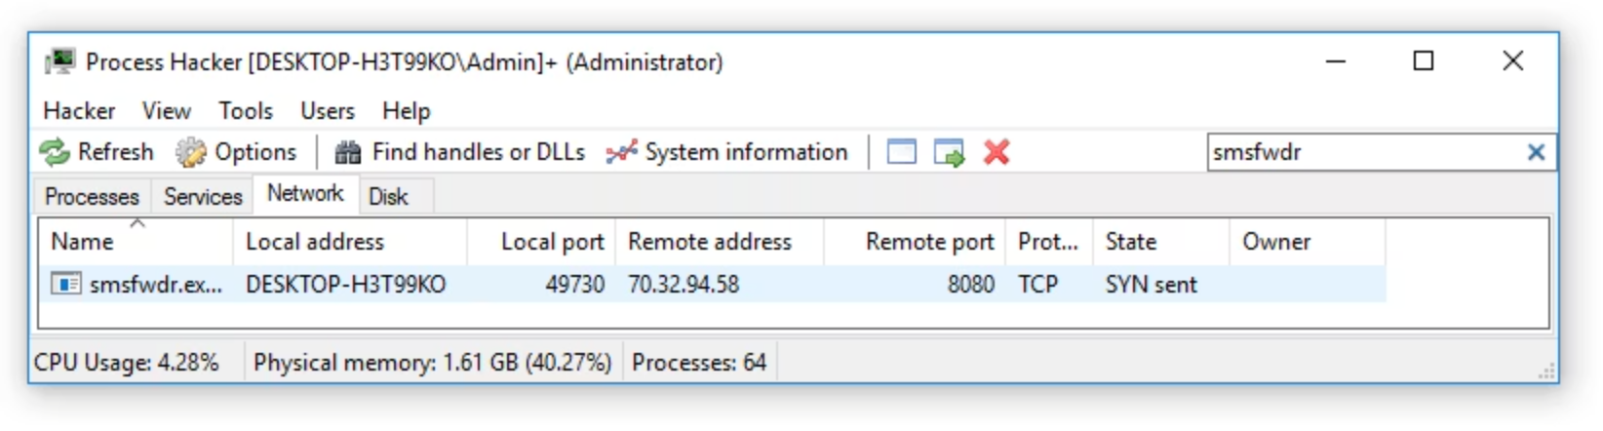
Isolating Network Traffic from Specific Processes
Process Filtering
Benefits for Analysis
Process Hacker allows you to filter network connections by specific process names, making it easier to focus on suspicious processes.
Isolates malware communication patterns
Reveals destination IPs and ports
Identifies communication protocols
In this example, filtering for "smsfwdr" (an Emotet malware process) reveals only the network connections associated with this malicious process.
Helps understand malware behavior
This targeted view helps analysts understand exactly how malware communicates with its controllers, providing crucial intelligence for incident response.

Slide 11
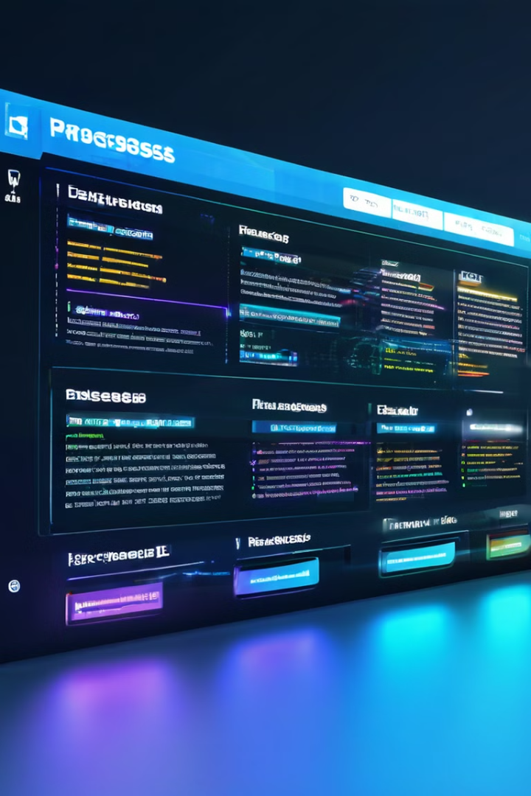
Process Manager
Process Hacker is a free and open-source system utility that provides a powerful and versatile way to manage and monitor processes on your Windows computer. It offers a wide range of features for advanced users, system administrators, and anyone looking to gain a deeper understanding of their system's behavior. With its user-friendly interface and comprehensive capabilities, Process Hacker empowers you to take control of your system, identify and troubleshoot issues, and optimize performance.

Slide 12
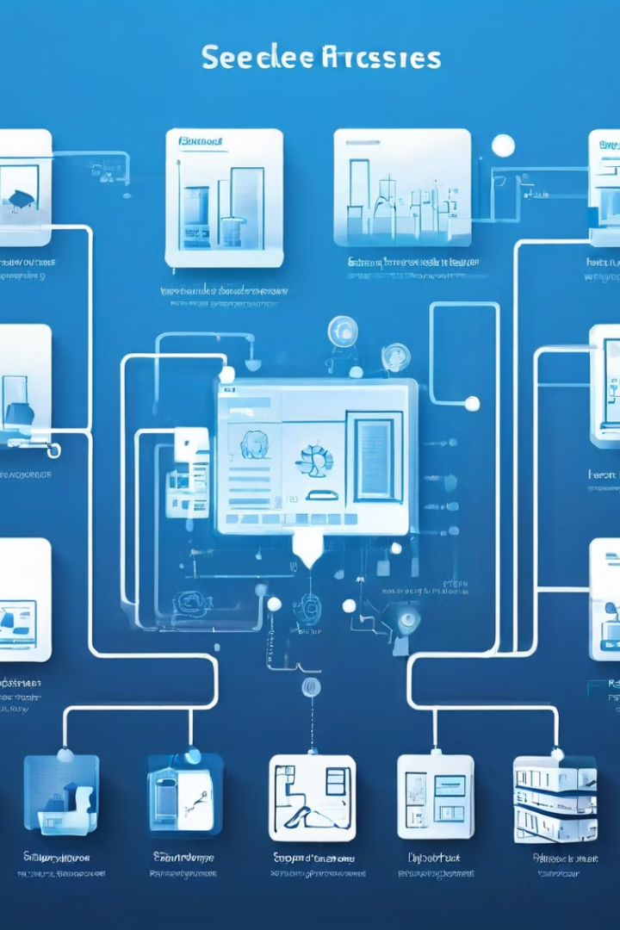
Understanding System Processes
1
Process Definition
2
Process Types
A process is a program in execution, a running instance of an application. Each process has its own memory space, resources, and a unique identifier (Process ID or PID). Understanding how processes work is crucial for effective system management.
Windows runs a variety of processes, including system processes that manage core functions, user processes that represent applications you use, and background processes that run silently in the background.
3
Process States
4
Process Dependencies
Processes transition between different states throughout their lifetime, such as running, waiting, suspended, and terminated. Process Hacker provides detailed information about each process's current state.
Processes can be dependent on each other, meaning one process might need another process to function correctly. Understanding these dependencies can help you identify potential issues and resolve conflicts.

Slide 13

Monitoring and Managing Processes
1
Process Listing
Process Hacker provides a comprehensive list of all running processes, allowing you to easily identify and filter processes based on various criteria such as name, PID, CPU usage, and memory usage.
2
Process Details
Clicking on a process in the list opens a detailed view, providing information about its memory usage, CPU usage, network activity, handles, modules, and other relevant metrics. This information can be used to monitor a process's performance and identify potential issues.
3
Process Control
Process Hacker enables you to control running processes, such as suspending, resuming, terminating, and changing their priority. These actions can help you manage system resources, optimize performance, and resolve conflicts.

Slide 14
Identifying and Terminating Malicious Processes
Suspicious Processes
Process Termination
Malware Detection
Process Hacker can help you identify suspicious processes by displaying their file path, owner, and other attributes. This information can be used to determine if a process is legitimate or potentially malicious.
If you identify a suspicious process, you can terminate it directly from Process Hacker. It's important to be cautious and ensure you're not terminating essential system processes.
Process Hacker can be used in conjunction with other security tools to identify and remove malware. It provides valuable information about the behavior of running processes, which can be helpful in identifying malicious activities.

Slide 15

Optimizing System Performance
Resource Monitoring
Process Prioritization
Process Hacker provides real-time monitoring of system resources such as CPU, memory, disk I/O, and network traffic. This information can be used to identify resource bottlenecks and optimize performance.
You can change the priority of processes to allocate system resources more effectively. Setting higher priority to performance-critical processes can improve responsiveness and overall system performance.
Process Termination
System Tuning
Terminating unnecessary or resource-intensive processes can free up resources and improve system performance. This is particularly helpful for applications that consume a lot of CPU or memory.
Process Hacker can be used in conjunction with other system optimization tools to fine-tune system settings and improve performance. It provides insights into the behavior of running processes, which can guide system optimization efforts.

Slide 16
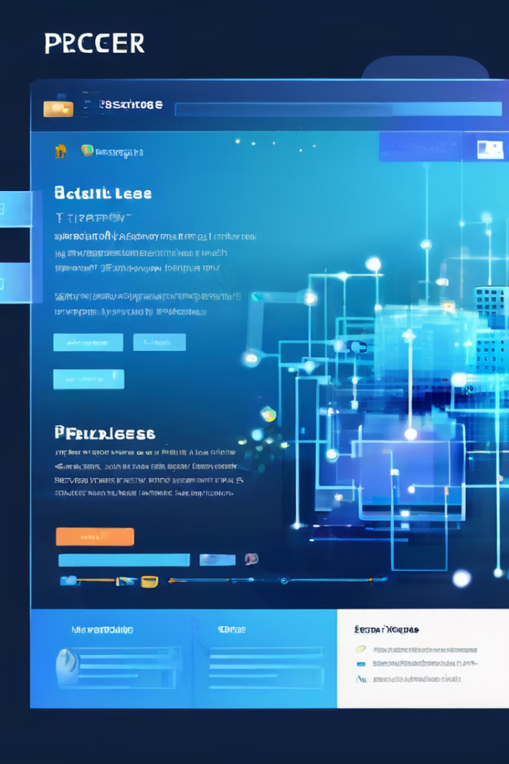




Troubleshooting Application Issues
Process Analysis
By examining a process's memory usage, CPU usage, network activity, and other metrics, you can identify potential problems that might be causing the application to malfunction.
Dependency Check
Process Hacker can help you identify the dependencies of an application, which can reveal issues related to missing or incompatible components.
Resource Conflicts
Process Hacker can help you identify resource conflicts between applications, such as two applications vying for the same resources, leading to performance issues or crashes.
Error Logging
Process Hacker can provide insights into error logs associated with a specific application, helping you understand the nature of the problem and potential solutions.

Slide 17
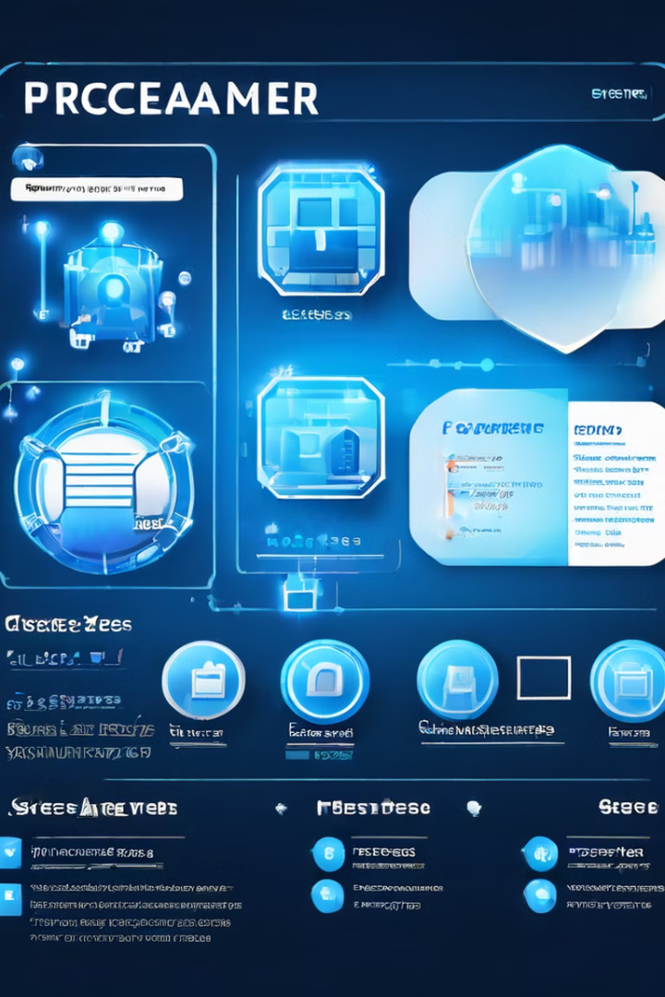
Advanced Features and Customization
Modules
Process Hacker offers a wide range of modules that extend its functionality. These modules include features such as memory analysis, registry editing, and system information gathering.
Plugins
Process Hacker supports third-party plugins that can add even more features and capabilities. These plugins can be used for tasks such as process monitoring, system optimization, and malware detection.
Customization
Process Hacker allows you to customize its appearance, behavior, and functionality to suit your preferences. You can change the interface theme, define custom hotkeys, and configure settings for advanced users.
Scripting
Process Hacker provides a scripting language that allows you to automate tasks and create custom scripts to manage processes and perform other system operations.

Slide 18





Conclusion and Key Takeaways
System Control
Troubleshooting
Security
Customization
Process Hacker empowers you to take control of your system, manage and monitor processes, and gain a deeper understanding of how your system works.
Process Hacker provides valuable tools for troubleshooting application issues, identifying resource conflicts, and resolving performance problems.
Process Hacker can help you identify and terminate suspicious processes, contributing to a more secure system by protecting against potential malware and threats.
Process Hacker's advanced features and customization options allow you to tailor it to your specific needs and preferences.

Slide 19
Real-time System Monitoring
Resource Consumption
Process Analysis
Troubleshooting
Process Hacker provides detailed graphs and statistics that allow you to monitor resource consumption in real-time. This includes CPU usage, memory allocation, disk activity, and network traffic. By observing these metrics, you can identify processes that are consuming excessive resources, leading to system slowdowns or instability.
You can easily navigate through the list of running processes and delve into their individual details. This includes information such as the process name, path, user, CPU and memory usage, network connections, and opened files. This level of detail enables you to pinpoint specific processes that might be causing problems or exhibiting unusual behavior.
Process Hacker's real-time monitoring capabilities can be invaluable for troubleshooting system issues. You can observe how resource consumption changes over time, identify processes that spike in activity, and investigate potential bottlenecks. This allows you to quickly pinpoint the root cause of system performance issues and take appropriate action.

Slide 20

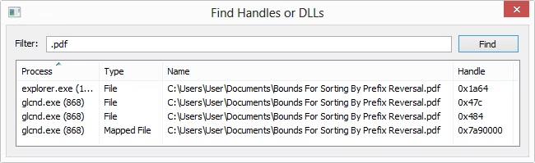
Handle and File Management
Handle Exploration
Process Hacker allows you to investigate which processes are holding onto specific files or resources. This is especially useful when you encounter situations where you are unable to edit or delete a file, as you can identify the processes that are locking it.
Handle Closure
In some cases, you might need to close a specific handle to gain control over a file or resource. Process Hacker provides the ability to close handles associated with files or DLLs. However, this should be used with caution as it can potentially lead to data loss or corruption if not performed correctly.
Process Prioritization
Understanding which processes are actively using files or resources can help you prioritize your actions. You might decide to terminate a process that is excessively holding onto a file, or you might choose to adjust the process's priority to reduce its resource consumption.

Slide 21

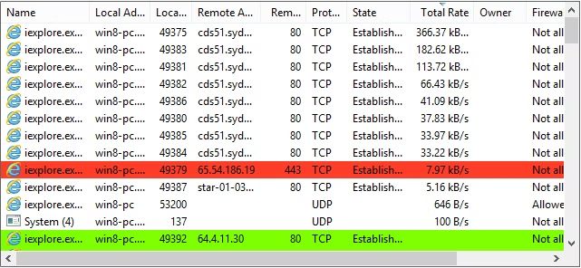
Network Connection Monitoring
1
Active Connections
Process Hacker provides a clear overview of all active network connections established by running processes. You can easily see which programs are communicating over the network, the destination addresses and ports, and the type of protocol being used.
2
Network Analysis
By examining the network connections, you can gain insights into how processes are interacting with the network. You might discover suspicious connections, excessive network traffic, or identify programs that are unintentionally leaking information over the network.
3
Troubleshooting Network Issues
Process Hacker helps you troubleshoot network problems by providing a detailed view of network activity. You can identify processes that are experiencing network errors or are consuming excessive bandwidth. This information can be invaluable for diagnosing and resolving network connectivity issues.
4
Security Monitoring
By monitoring network connections, you can identify potentially malicious processes that are attempting to communicate with remote servers or engage in unauthorized network activity. Process Hacker network monitoring capabilities can be valuable for detecting and preventing network-based threats.

Slide 22

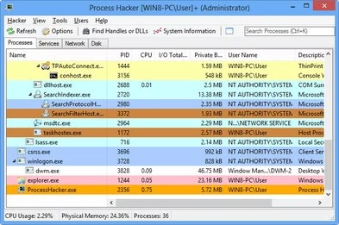
Comprehensive System Activity Overview
1
Process Information
Process Hacker displays a comprehensive list of all running processes, including their names, paths, user accounts, and associated resources.
2
Performance Metrics
The tool provides real-time metrics for CPU usage, memory allocation, disk activity, and network traffic, allowing you to monitor system performance in detail.
3
Thread and Module Information
Process Hacker dives deep into individual processes, offering information about their threads, modules, and associated handles, providing a detailed view of their internal workings.
4
Extended Details
You can customize the displayed columns to include additional information like process priority, memory usage history, and stack traces. This allows you to tailor the information displayed to your specific needs and analysis goals.

Slide 23
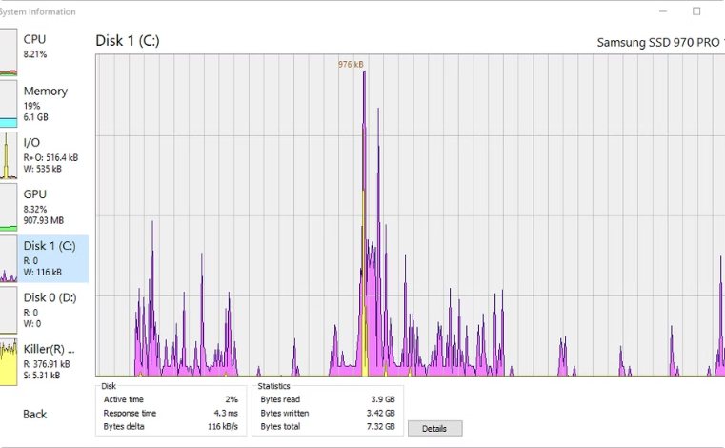
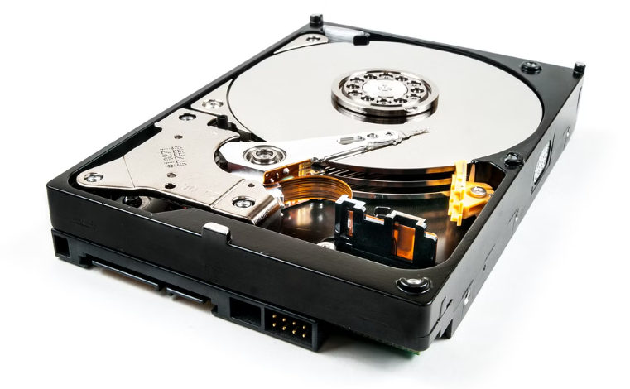
Disk Activity Analysis
Disk Activity Monitoring
Performance Optimization
Process Hacker provides a detailed view of disk activity, allowing you to monitor the read and write operations performed by various processes on different drives.
By analyzing disk activity, you can identify processes that are causing excessive disk usage or slowdowns. This information allows you to optimize system performance by adjusting process priorities, relocating data, or identifying potential bottlenecks.

Slide 24


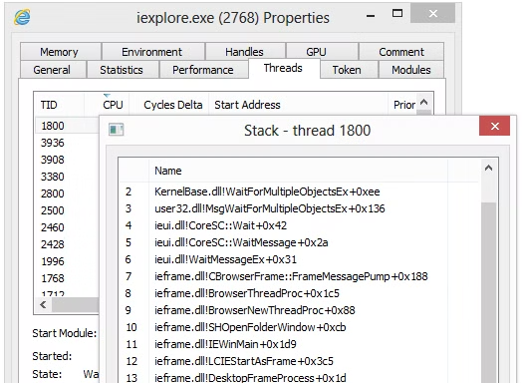


Thread Stack Traces
Debugging
Process Hacker allows you to view detailed stack traces for individual threads. These traces provide a step-by-step record of the function calls that have been made by a thread, offering insights into its current execution state.
Crash Analysis
When a program crashes, analyzing thread stack traces can help you understand the sequence of events that led to the crash. This information is crucial for identifying the root cause of the crash and debugging the faulty code.
Performance Analysis
Stack traces can also be used to analyze performance bottlenecks. By examining the function calls in a thread's stack, you can identify areas where excessive time is being spent, leading to performance degradation.

Slide 25

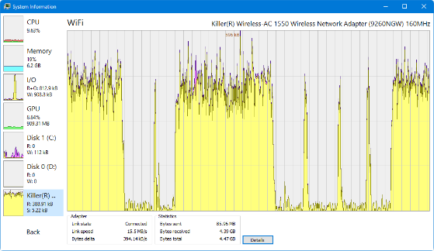
Network Usage Analysis
Network Adapters
Network Usage
Detailed Statistics
Monitoring Bandwidth Consumption
Process-Level Breakdown
Identifying Network Issues

Slide 26
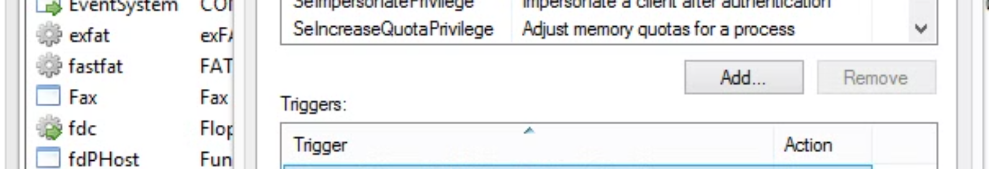




Service Management
Service Control
Service Management
Service Configuration
Driver Services
Process Hacker provides an advanced interface for managing Windows services, offering a comprehensive alternative to the traditional services.msc utility.
You can start, stop, restart, or pause services directly from Process Hacker, granting you granular control over your system's services.
The tool allows you to modify service properties, including their startup type, dependencies, and descriptions, enabling you to customize service behavior to your preferences.
Process Hacker displays entries for both normal user-mode services and driver services, providing a comprehensive view of all active services on your system.

Slide 27

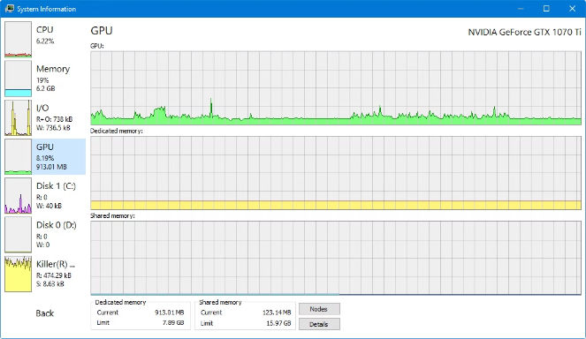
GPU Usage Monitoring
1
GPU Utilization
Process Hacker allows you to monitor the GPU usage of running processes, providing insights into how different applications are utilizing the graphics processing unit.
2
Performance Analysis
By observing GPU usage, you can identify processes that are consuming excessive GPU resources, potentially causing slowdowns or performance issues.
3
Troubleshooting
Process Hacker's GPU usage monitoring can help troubleshoot graphics-related problems, allowing you to identify the root cause of performance issues or rendering glitches.
4
Resource Allocation
You can prioritize processes that are more demanding of GPU resources, ensuring that they receive sufficient access to the graphics processing unit for optimal performance.

